Slide 1
FNHSSM Website Design

Slide 2
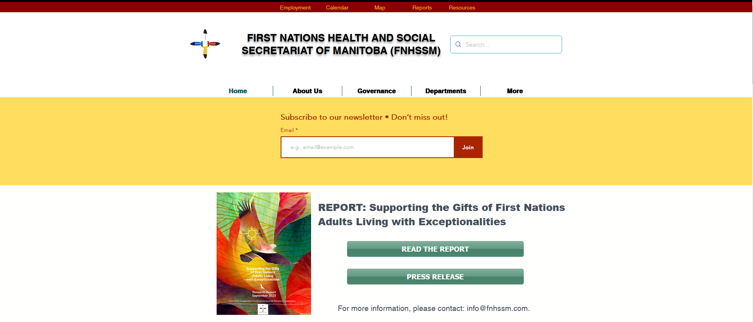
Current website design
The user experience is not intuitive
Doesn’t comply with mobile web standards.
Doesn’t reflect the current work done by FNHSSM

Slide 3
New website design
Streamlined the design
Creating graphic templates for social media that match the website theme
Mobile combatable, and will be built to accessibility standards
Last updated time stamps on all the pages to ensure responsibility on our end to keep pages updated with current information

